Slide 1
Genome Assembly and Differential Expression of Enterococcus faecium E745
Paper I – RNA-seq and Tn-seq reveal fitness determinants of vancomycin-resistant Enterococcus faecium during growth in human serum (Zhang et al. 2017)

Slide 2
Overview
01
Introduction
Background and aim of study
05
Synteny
Aligning different species
02
Preprocessing
Quality control, trimming
06
Transcriptomics
Mapping, counting, comparing RNA
03
Assembly
Different assemblers
07
Results
04
Annotation
Finding genes

Slide 3
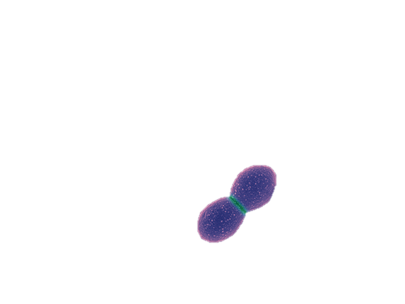
Enterococcus faecium
Multi-resistant (Clade A)
Hospital disease
Urinary tract and bloodstream
Strain: E745 from rectal swab (Clade A-1, NL)
Photo: https://www.indiamart.com/proddetail/enterococcus-faecium-probiotics-8411604530.html

Slide 4
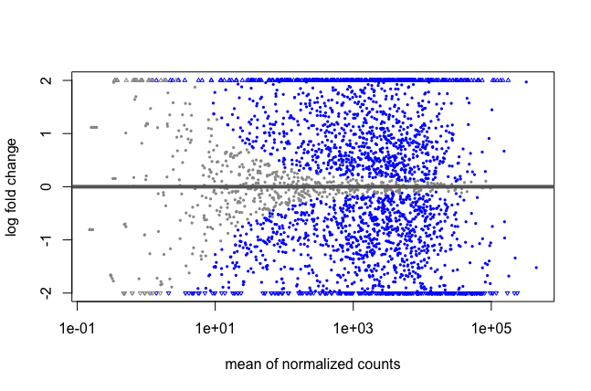
Aim
Identify genes responsible for growth in human serum

Slide 5
Data
DNAseq from:
PacBio RSII
illumina HiSeq 2500
NanoPore MinION 2D
RNAseq (and Tn):
illumina HiSeq 2500

Slide 6
02
Preprocessing
Quality Control with
FastQC
Trimming with
Trimmomatic

Slide 7
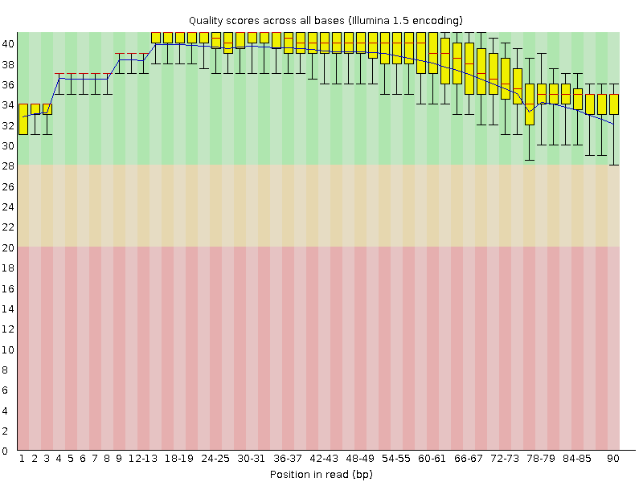
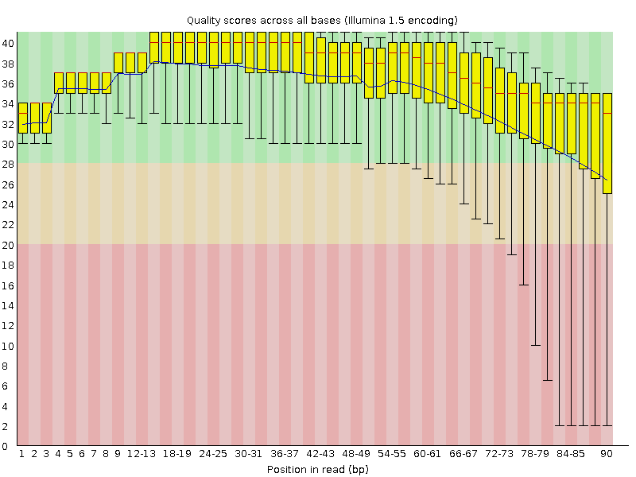

FastQC example
Illumina DNA read 1
Illumina DNA read 2
Before trimming
No significant difference – files already trimmed
After trimming

Slide 8
03
Assembly + evaluation

Slide 9
Assemblers
Canu
Spades
Pilon
PacBio
illumina
illumina + NanoPore
illumina + PacBio
illumina + NanoPore + PacBio
Canu_PacBio
+
Spades_*

Slide 10
Evaluation
BCF
MUMmerPlot
QUAST

Slide 11
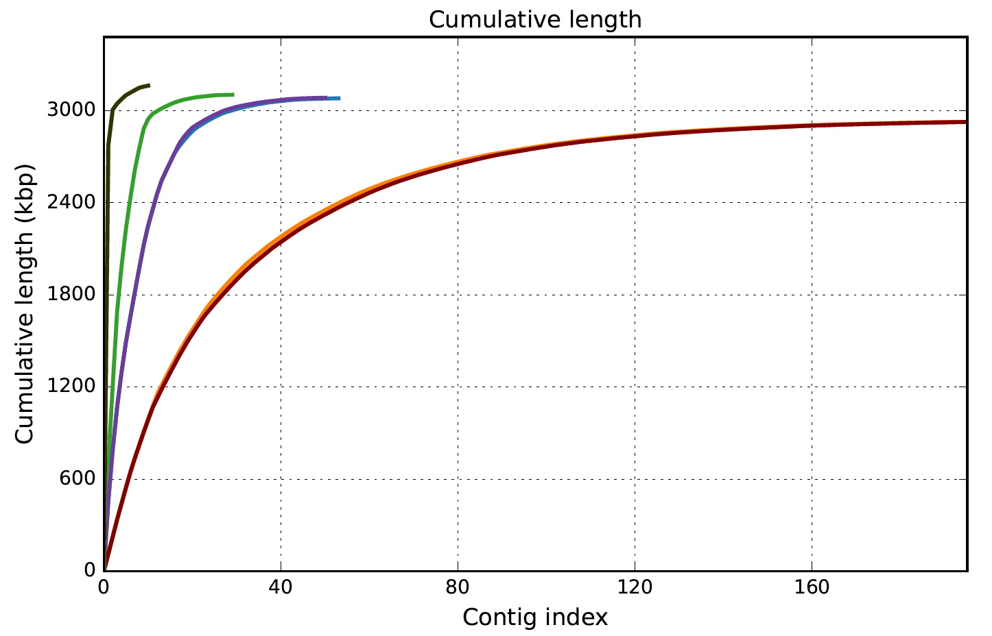
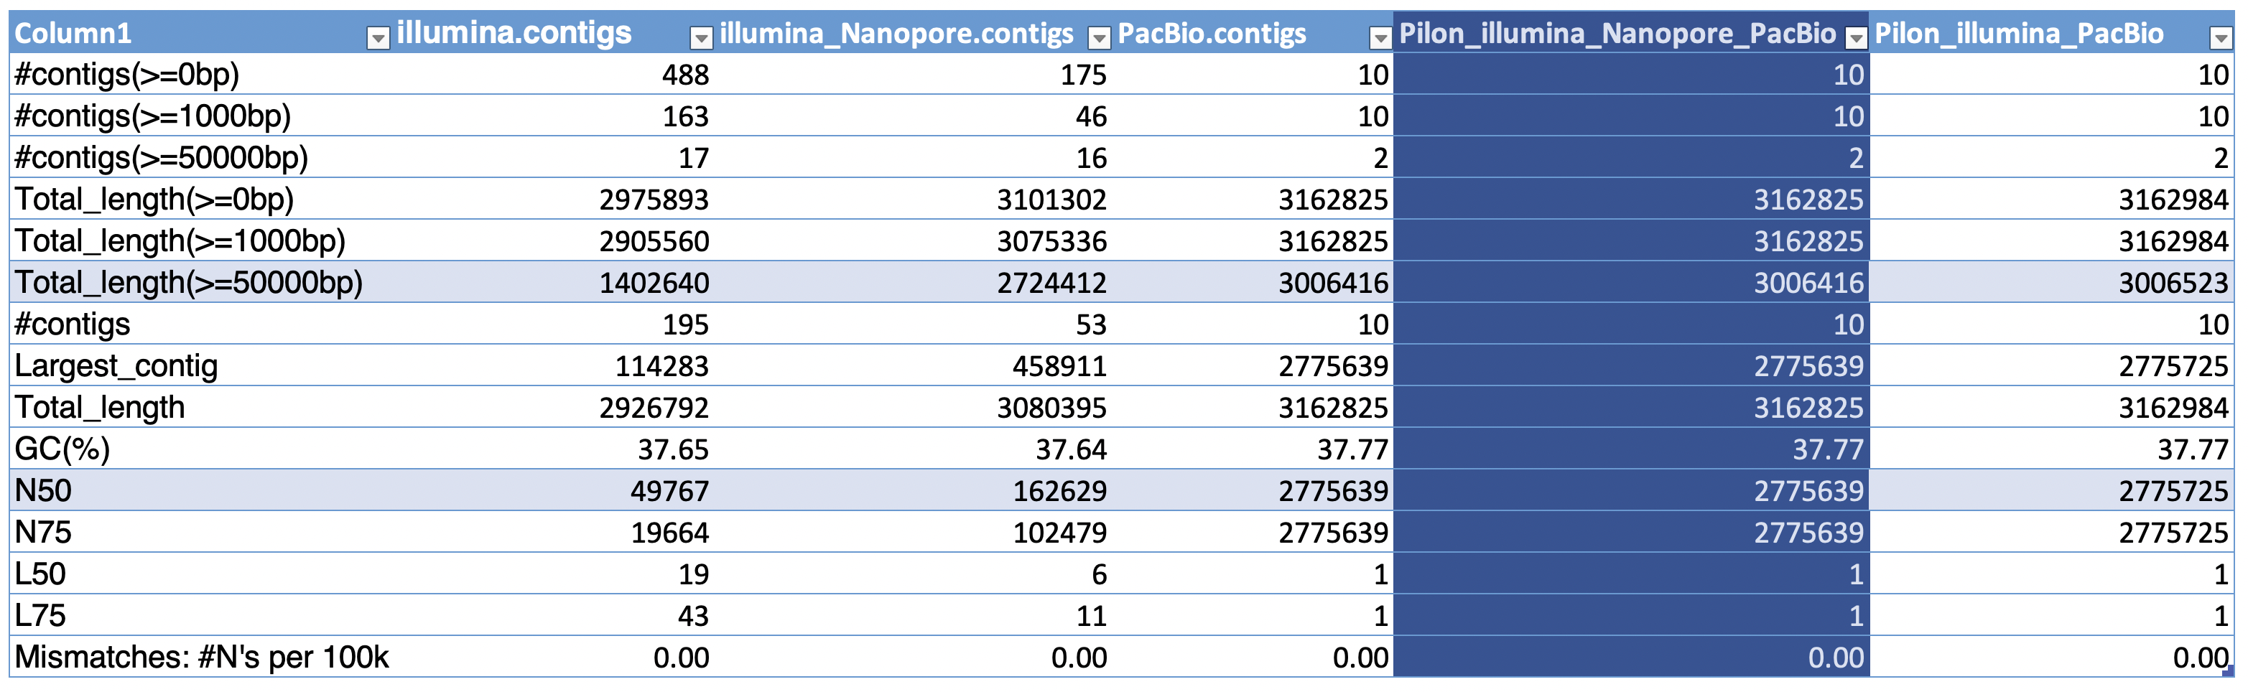
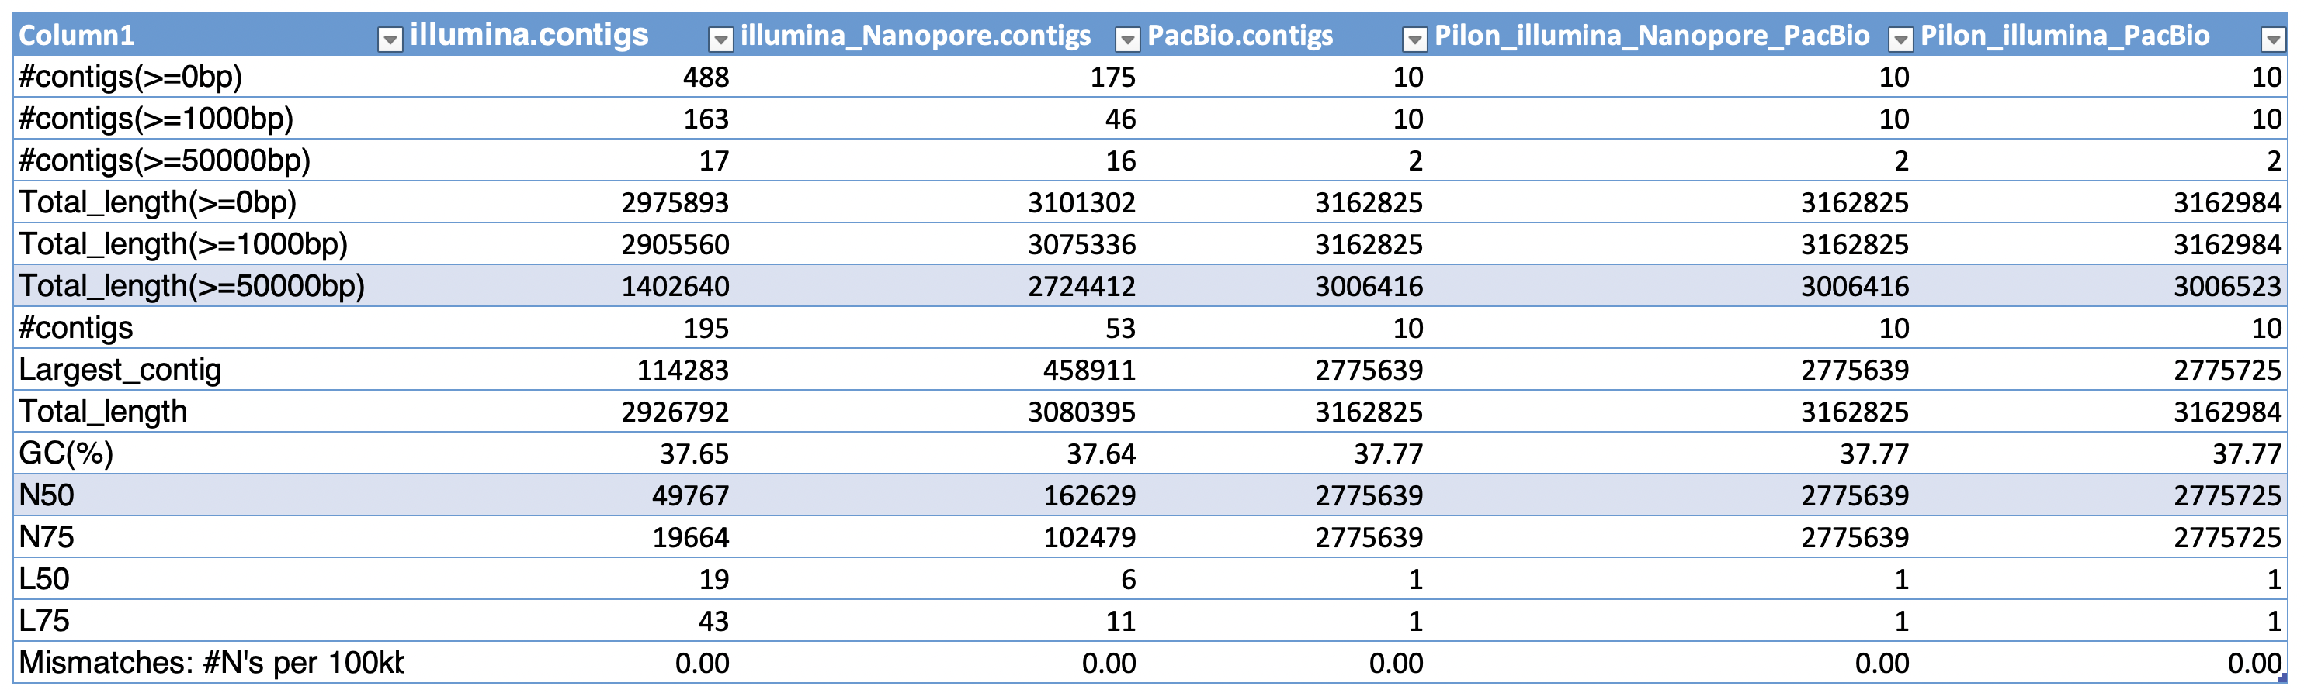
QUAST report

Slide 12
04
Annotation Prokka

Slide 13
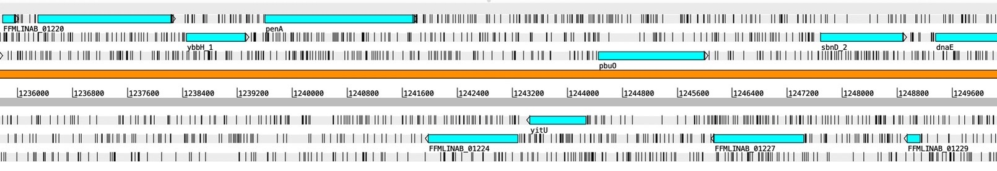
Prokka annotation
Findings:
rRNA
tRNA
tmRNA
CDS
(Excerpt from Artemis visualization)

Slide 14
05
Synteny Align, compare

Slide 15
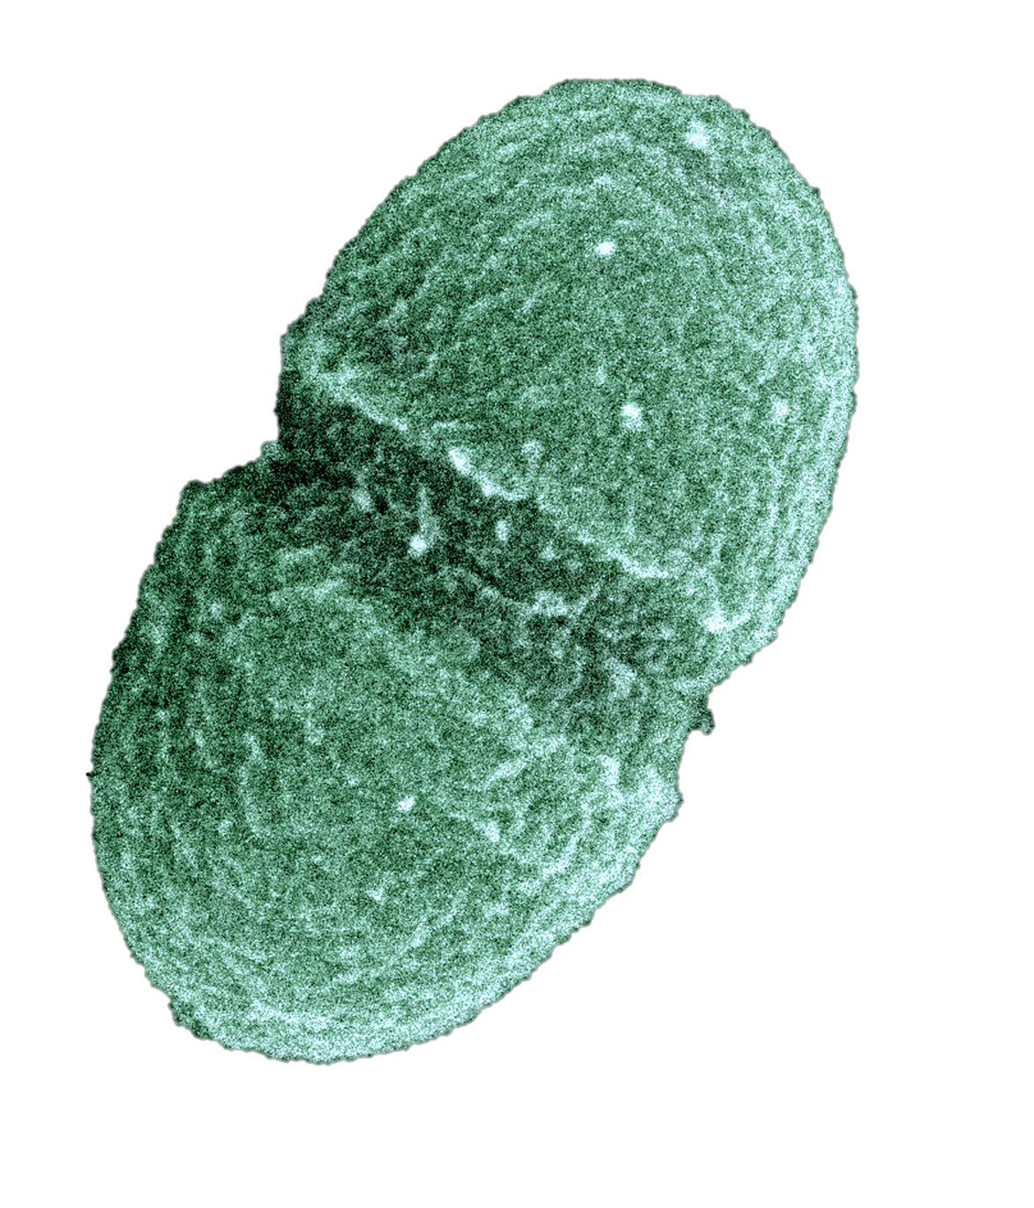
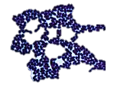
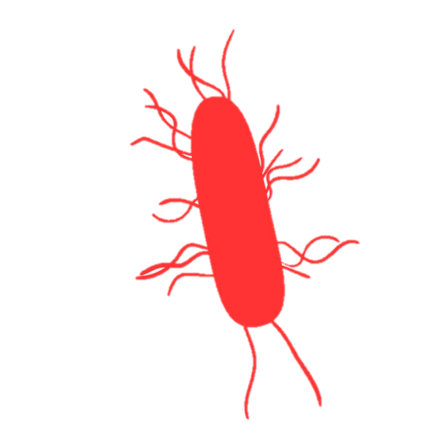
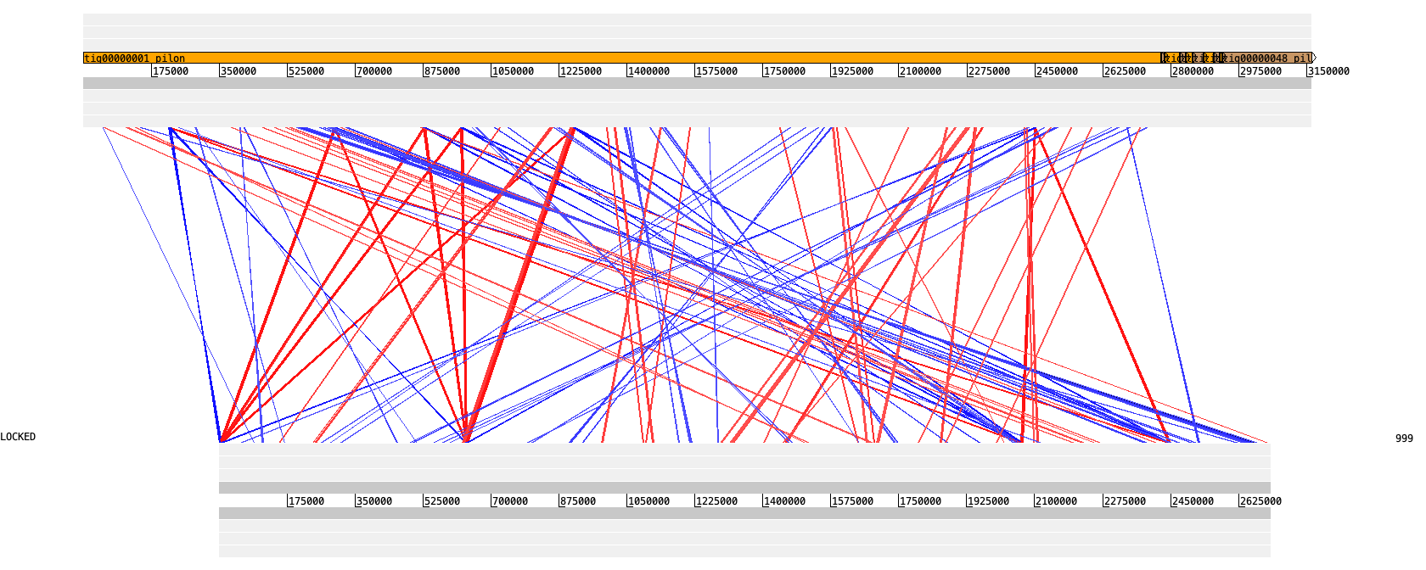
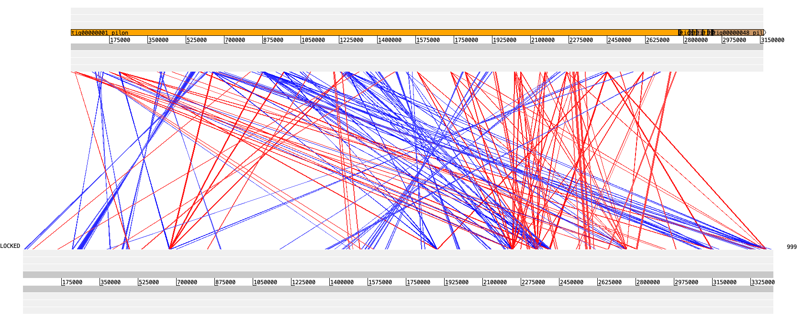
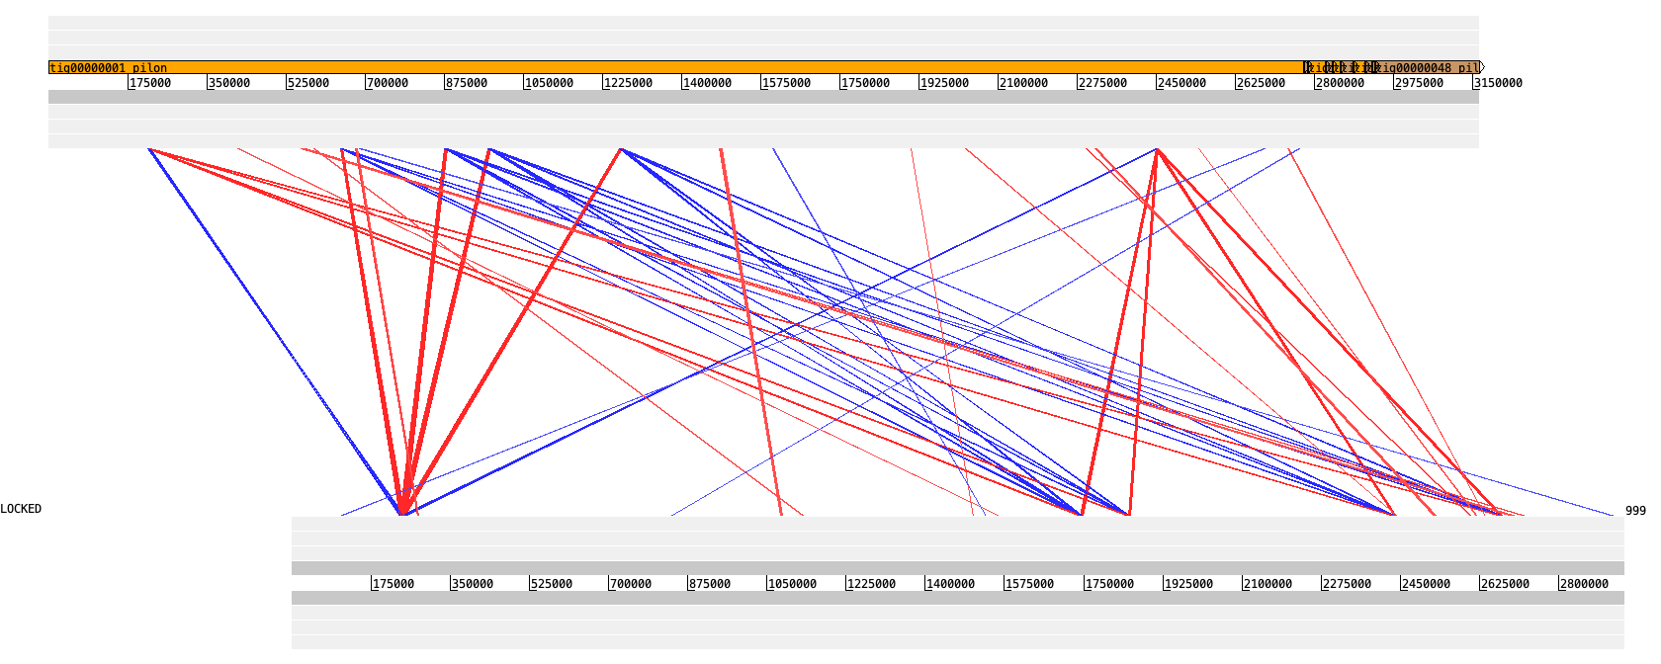
Synteny – E. faecium
E. faecalis
E. casseliflavus
L. monocytogenes
blastn alignment of whole genome. Visualized with Artemis ACT
Notes:
Listeria monocytogenes.
downloaded reference genomes from NCBI
photos:
https://www.google.com/url?sa=i&url=https%3A%2F%2Fen.wikipedia.org%2Fwiki%2FEnterococcus_faecalis&psig=AOvVaw0AYJzmL7Hm0OPHBVJI-pMS&ust=1621989126433000&source=images&cd=vfe&ved=0CA0QjhxqFwoTCOjk8MbK4_ACFQAAAAAdAAAAABAD
https://microbe-canvas.com/Bacteria.php?p=1239
https://www.google.com/url?sa=i&url=https%3A%2F%2Fwww.istockphoto.com%2Fphotos%2Flisteria-monocytogenes&psig=AOvVaw1L2AX4IyoGMbkyyhWhbLkm&ust=1621988615471000&source=images&cd=vfe&ved=0CA0QjhxqFwoTCJC1g7LK4_ACFQAAAAAdAAAAABAD

Slide 16
06
Transcriptomics Mapping, counting reads, compare

Slide 17
RNA seq
BWA
HTSeq count
DeSeq2
Mapping RNA reads onto genome assembly
Count number of reads mapped to each gene
Differential expression - visualized

Slide 18
07
Results

Slide 19
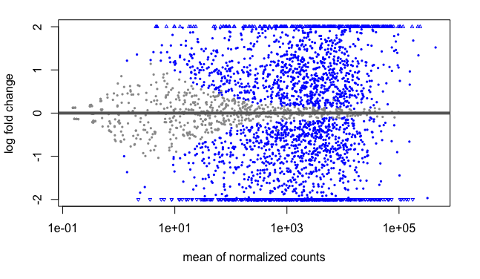
DeSeq2
(Excerpt from RStudio visualization. Log fold change vs LFC shrinkage)

Slide 20
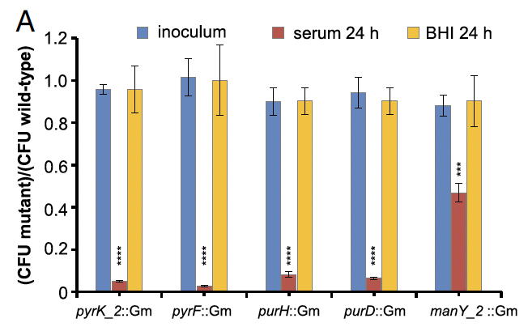
Example of Transposon effect
When these genes have transposon
Showing number of mutant survivors after 24h in serum and medium
Significant negative effect on viability in serum
Diagram from Zhang et al. 2017
Notes:
Transposon mutants in these genes have huge negative effect in growth in serum but no effect is observed in the BHI medium culture.

Slide 21
Conclusion
Good targets:
Genes involved in the nucleotide synthesis and carbohydrate metabolism pathways
(Zhang et al. 2017)

Slide 22
References
Zhang X, de Maat V, Guzmán Prieto AM, Prajsnar TK, Bayjanov JR, de Been M, Rogers MRC, Bonten MJM, Mesnage S, Willems RJL, van Schaik W. 2017. RNA-seq and Tn-seq reveal fitness determinants of vancomycin-resistant Enterococcus faecium during growth in human serum. BMC Genomics 18: 893.
https://canu.readthedocs.io/en/latest/tutorial.html#canu-the-command
https://cab.spbu.ru/files/release3.14.0/manual.html
https://support.illumina.com/bulletins/2016/04/fastq-files-explained.html
http://bioconductor.org/packages/devel/bioc/vignettes/DESeq2/inst/doc/DESeq2.html#htseq-count-input

Slide 23
THANK YOU

